Slide 1
Angular 2
Internals of Angular 2
Notes:
Add instructor notes here.

Slide 2
Change Detection
Angular 2 can detect when component data changes and then automatically re-render the view to reflect that change though its change detection implementation.
Angular 2 at startup time overrides several low-level browser APIs for instance addEventListener to run change detection and update the UI.
This low-level patching of browser APIs is done by a library shipped with Angular called Zone.js
The following frequently used browser mechanisms which usually cause changes are patched to support change detection
All browser events (click, mouseover, keyup, etc.)
Timers: setTimeout() and setInterval()
Ajax requests : XHR - Fetching data from a remote server
Zone.js intercepts all ASYNC operations
Angular has its own zone called NgZone to control Change Detections
Notes:
As a user interacts with our app, data (state) changes and our app needs to respond accordingly.
One of the big problems any modern JavaScript framework needs to solve is how to figure out when changes have happened and re-render components accordingly.
In order to make the view react to changes on components state, Angular uses change detection.
A zone is nothing more than an execution context that survives multiple JavaScript VM execution turns. It's a generic mechanism which we can use to add extra functionality to the browser. Angular uses zones internally to trigger change detection, but another possible use would be for application profiling, or keeping track of long stack traces that run across multiple VM turns.
Add instructor notes here.

Slide 3
How Change Detection works
Angular application will have a number of components that will interact with each other which creates a dependency tree.
Each component gets a change detector, so we end up with a tree of change detectors.
When one of the components change, no matter where in the tree it is, a change detection pass is triggered for the whole tree.
This happens because Angular scans for changes from the top component node, all the way to the bottom leaves of the tree (Unidirectional flow)
It gives a impression that this check may be a very expensive operation but angular generates VM friendly code for better performance which an perform hundreds of thousands of such checks in a few milliseconds.
Notes:
Add instructor notes here.

Slide 4
Customizing Change Detection
There are times that the built-in or default change detection mechanism may be overkill.
Angular provides mechanisms for configuring the change detection system such to get very fast performance.
Change detection should be optimized using Immutable Data and Observables
If immutable objects or observables used it checks only the parts of tree.
Change detector behavior can be changed by telling a component that it only should be checked if one of its input values change by setting its changeDetection attribute to ChangeDetectionStrategy.OnPush
The default value for changeDetection is ChangeDetectionStrategy.Default.
Notes:
Add instructor notes here.

Slide 5
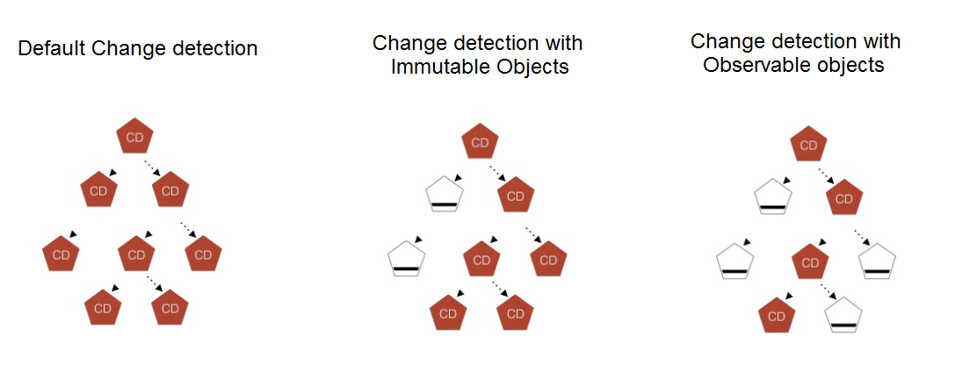
Angular 2 change detection system
Notes:
Add instructor notes here.

Slide 6
Demo
ChangeDetection
Notes:
Add the notes here.
Add instructor notes here.

